Slide 1

COLORED NOTES
Testing of the Microsoft app
https://apps.microsoft.com/store/detail/colored-note/9NBLGGH51BL1
Environment: Windows 10
OS Build 19044.3086

Slide 2
COLORED NoTES
Colored Notes simple and easy to use. Write notes, reminders, messages, to-do lists and shopping. Intuitive interface, easy operation, the original design, a great feature set . Handwritten text, photos, and text input from the keyboard.
* Features *
• Draw directly on your display
• Create a to-do list (Shopping List)
• Ample room for text editing
• 16 themes
• Each note its color
• Type notes - list or tile
• Sorting notes by color
• Adding photos to a note
• Selecting photos from the gallery or a picture in real time

Slide 3
TESTING REVIEW REPORT
TESTING REVIEW
Types of tests | Number | % | FUNCTIONAL | NON-FUNCTIONAL
Passed | 54 | 83 | 38 | 16
Failed | 11 | 17 | 9 | 2
Total | 65 | 100 | 47 | 18

Slide 4
DEFECT STATISTICS
DEFECT STATISTICS
Priority | Number
High | 4
Medium | 4
Low | 3
Total | 11
SUMMARY REPORT
11 Defects ( 4 HIGH priority, 4 MEDIUM priority and 3 LOW priority) found
5 IMPROVEMENTS suggested

Slide 5
SMOKE TEST
App’s Installation
Location of downloaded file
Making a simple NOTE
Open created NOTE
Check if created NOTE has been saved
App’s Uninstallation
All SMOKE TEST’s - PASS

Slide 6
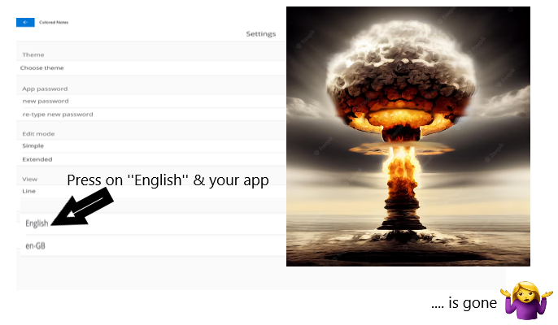
‘’BUG ‘’ That remembered the most

Slide 7
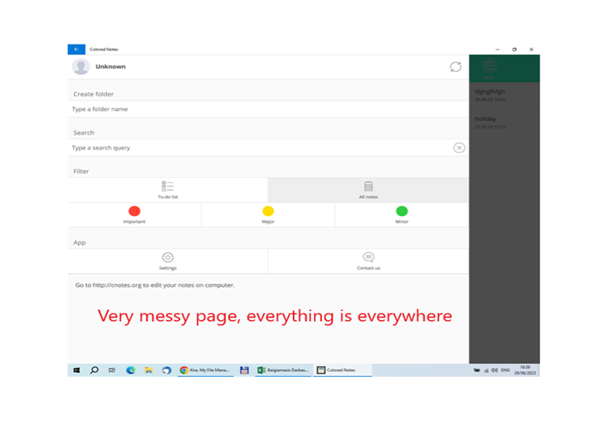
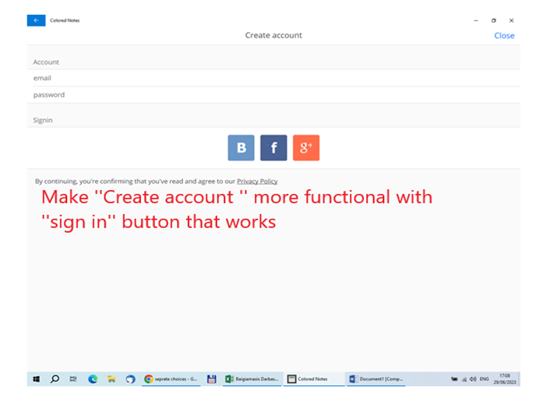
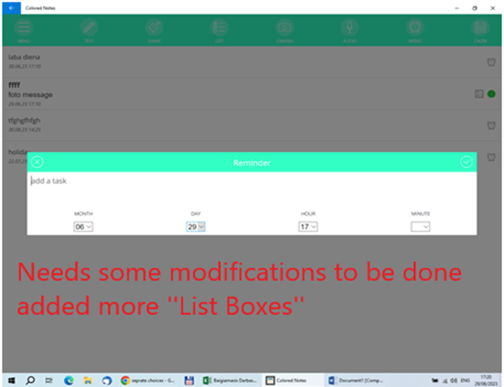
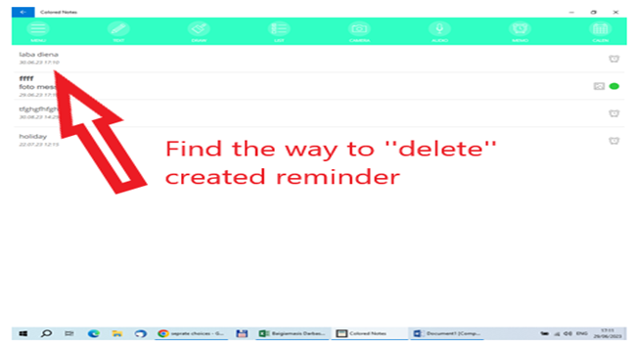
App’s ‘’Colored notes’’ suggestions for improvements
Often asked questions
MENU field – more understandable
Create account – make it more clearer
Memo/reminder – add more function’s
Memo/reminder – delete option

